Slide 1
Flixverse: Movie Recommendation Platform
Done By:
Abdelrahman Yaser Abdelrahim
Hazem Saad Bayoumi
Katrean Adel Napil
Mostafa Ahmed Mohamed

Slide 2
Problem Statement
Users struggle to find tailored movie recommendations.
Goal: Simplify discovery with genre/trend-based browsing.

Slide 3
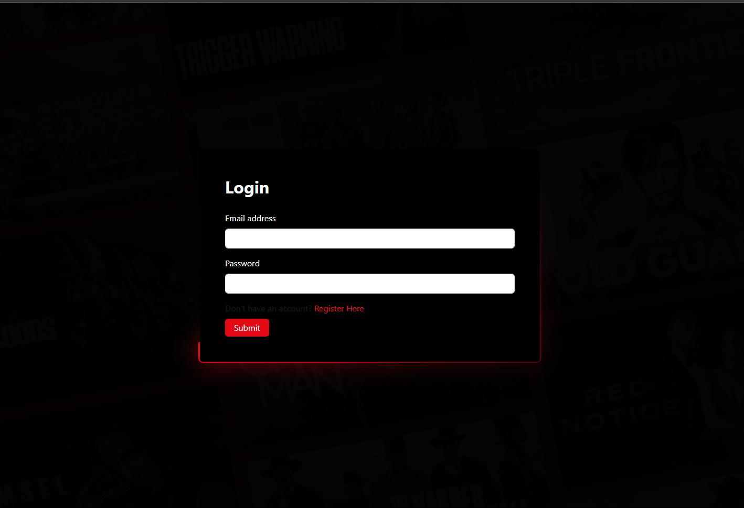
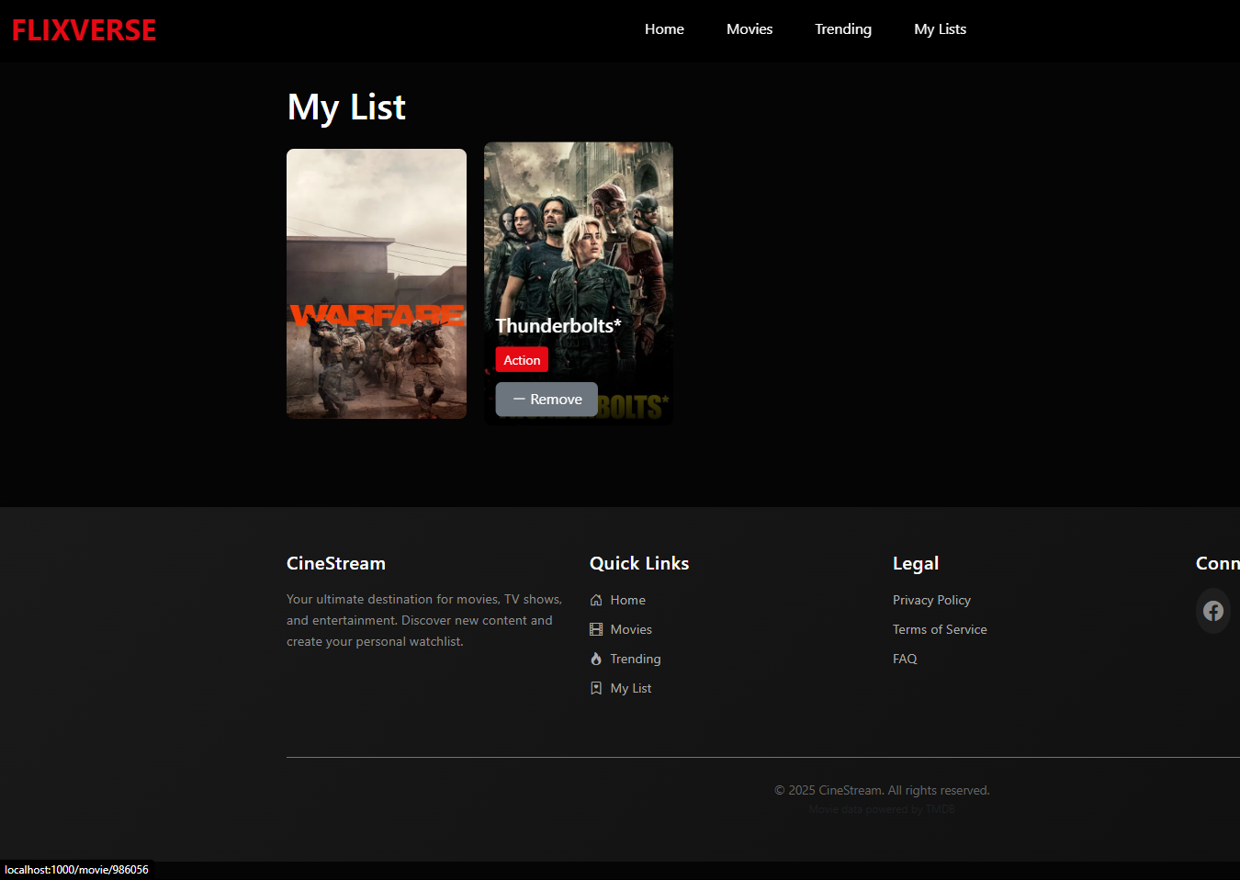
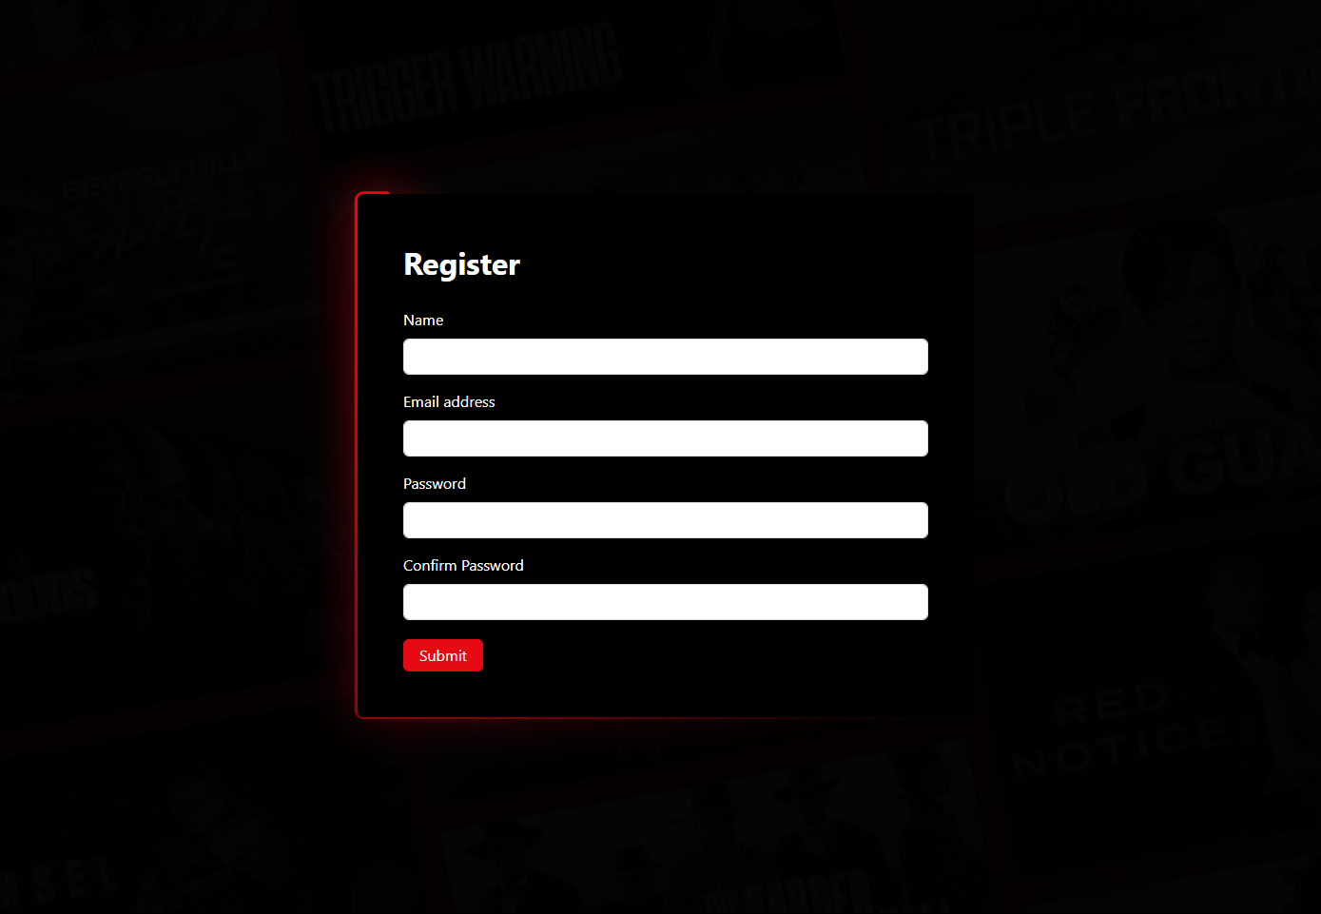
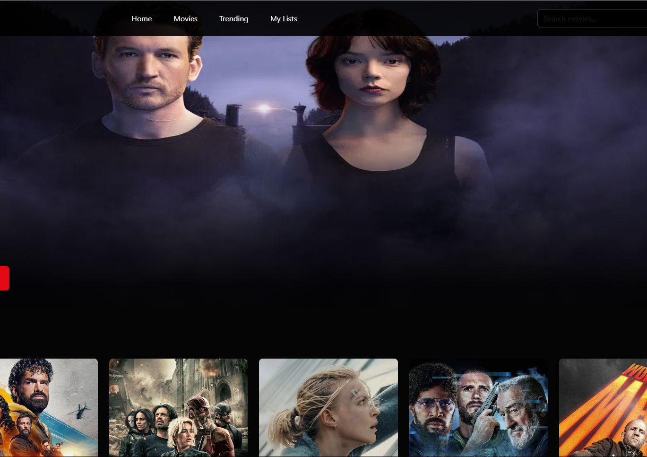
Key Features
Visual demo (screenshots) of:
Login/Register flow.
Home page with featured content.
"My List" persistence.

Slide 4
Tech Stack
Frontend: React, Bootstrap.
API: TMDB integration.
State: localStorage, React Hooks.

Slide 5
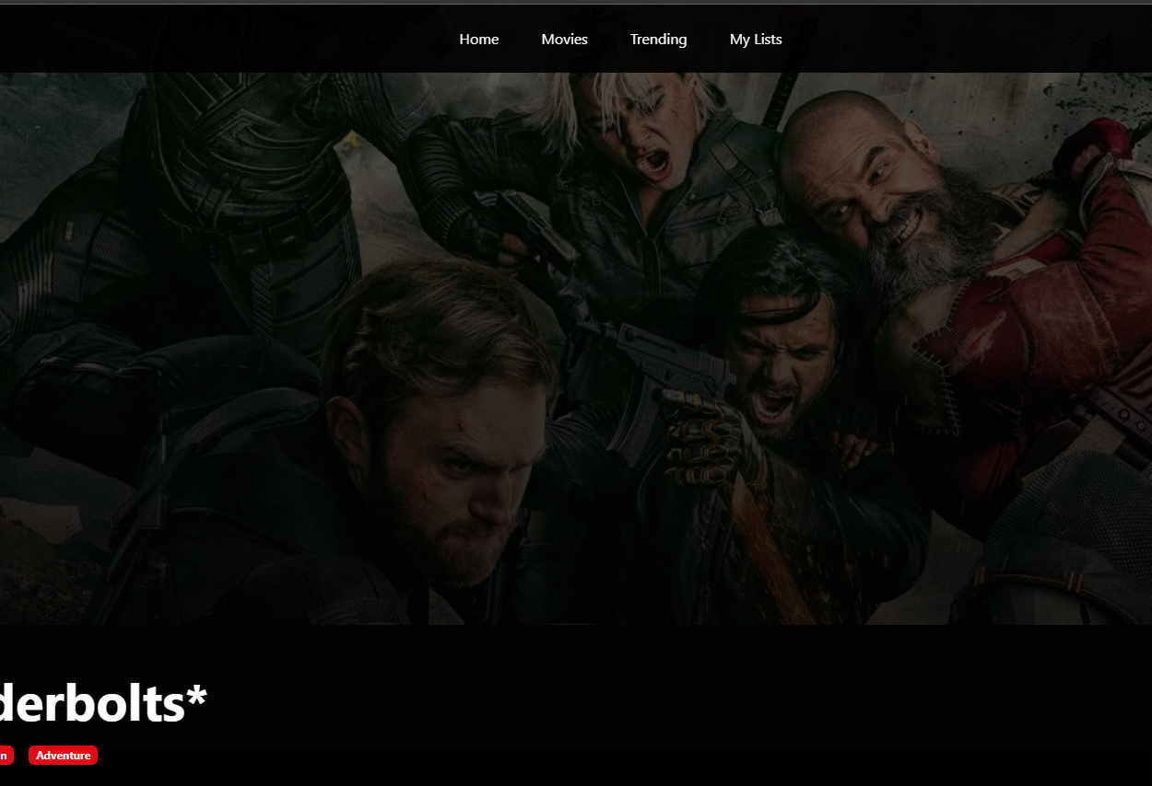
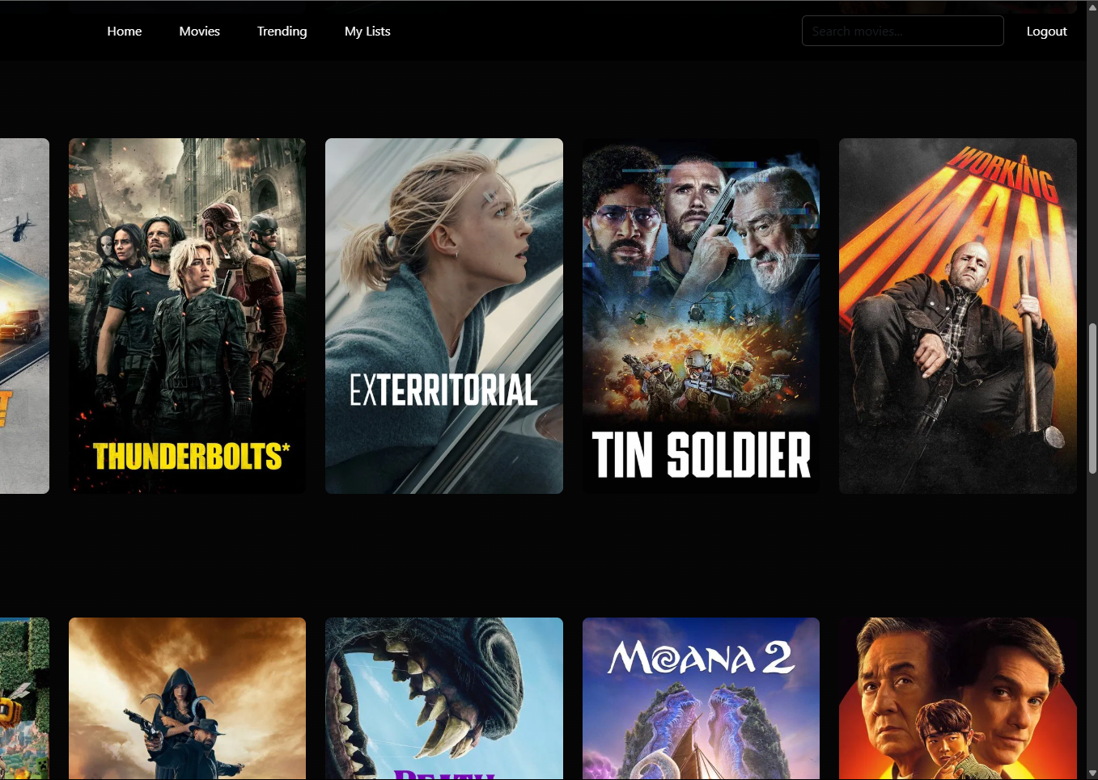
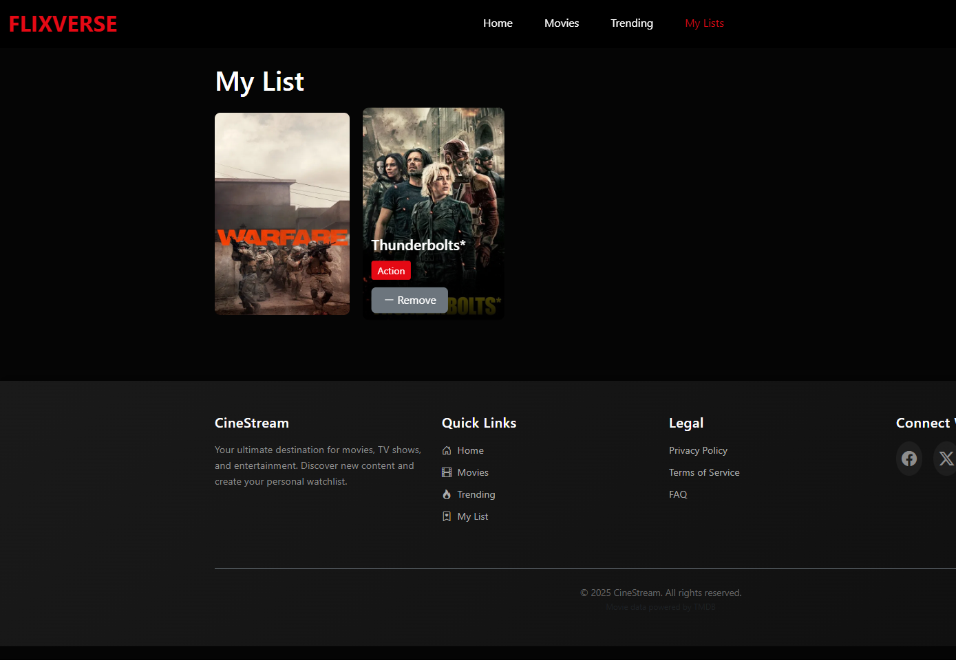
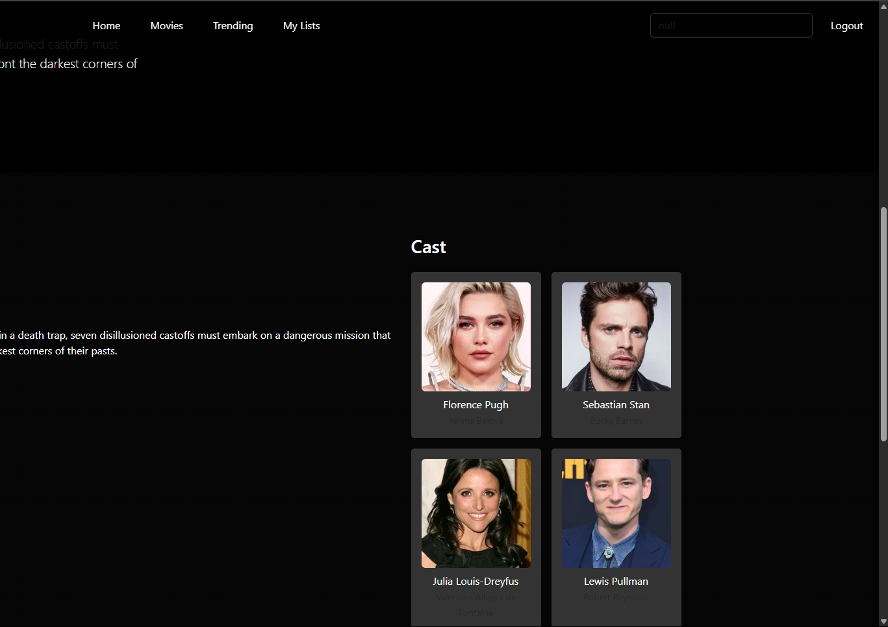
Demo Walkthrough
Genre sections
Details page
My List

Slide 6
Future Scope
User profiles, notifications, advanced filters.

Slide 7
Thank You

